Slide 1
DXC REAL-TIME PROJECTS
PRESENTED BY:
PREETHI L
DXC262AB1237

Slide 2
CONTENTS
PROJECT 1: CONNECTED VEHICLES
PROJECT 2: AP MORGAN DATA PLATFORM

Slide 3
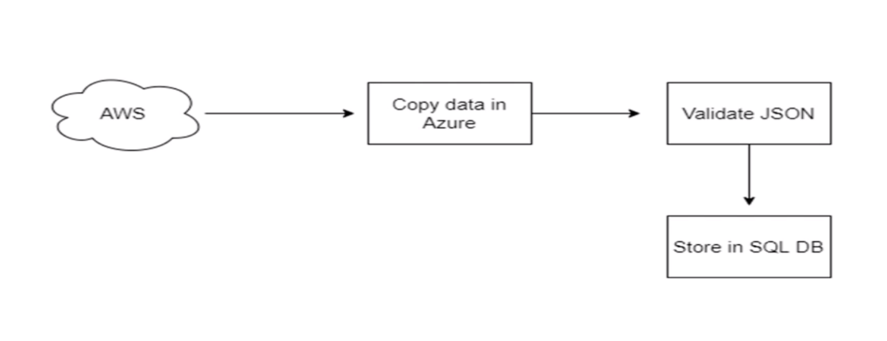
PROJECT 1 : CONNECTED VEHICLES
AIM: Moving data from Staging to SQL DB using pipelines.
PROJECT OUTLINE:

Slide 4
MODULES
Creating Azure data factory
Creating Azure data factory pipeline
Creating blob trigger logic
Creating Azure SQL server and database
Adding another pipeline to move data from staging to SQL database

Slide 5
RESOURCES
To complete this project we need the resources
Azure Data Factory
Azure Storage Account
Azure SQL Database

Slide 6

AZURE DATA FACTORY
Azure Data Factory is the platform that solves such data scenarios. It is the cloud-based ETL and data integration service that allows you to create data-driven workflows for orchestrating data movement and transforming data at scale.

Slide 7
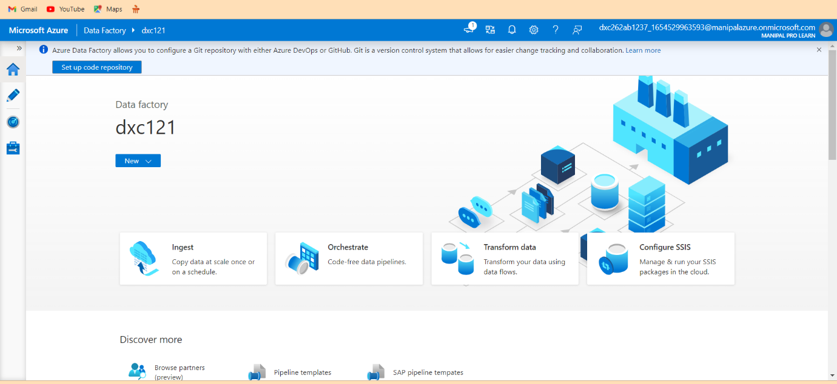
AZURE DATA FACTORY
Create Azure Data Factory

Slide 8
AZURE STORAGE ACCOUNT
An Azure storage account contains all of your Azure Storage data objects, including blobs, file shares, queues, tables, and disks.
The storage account provides a unique namespace for your Azure Storage data that's accessible from anywhere in the world over HTTP or HTTPS.

Slide 9
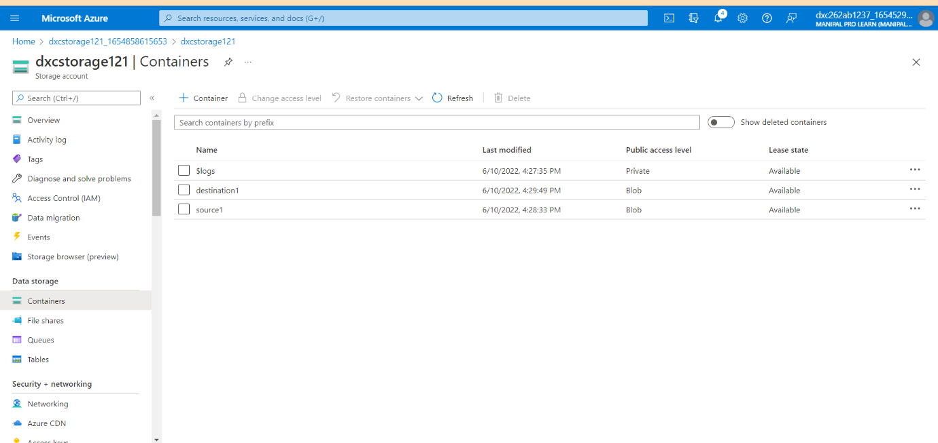
AZURE STORAGE ACCOUNT
Create an Azure Storage Account with source and destination.

Slide 10
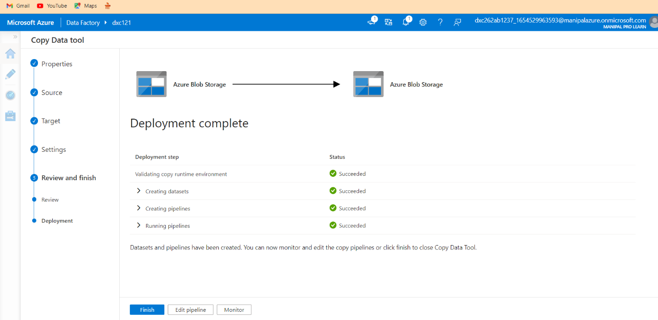
CREATE AZURE DATA FACTORY PIPELINE
Pipeline created.

Slide 11
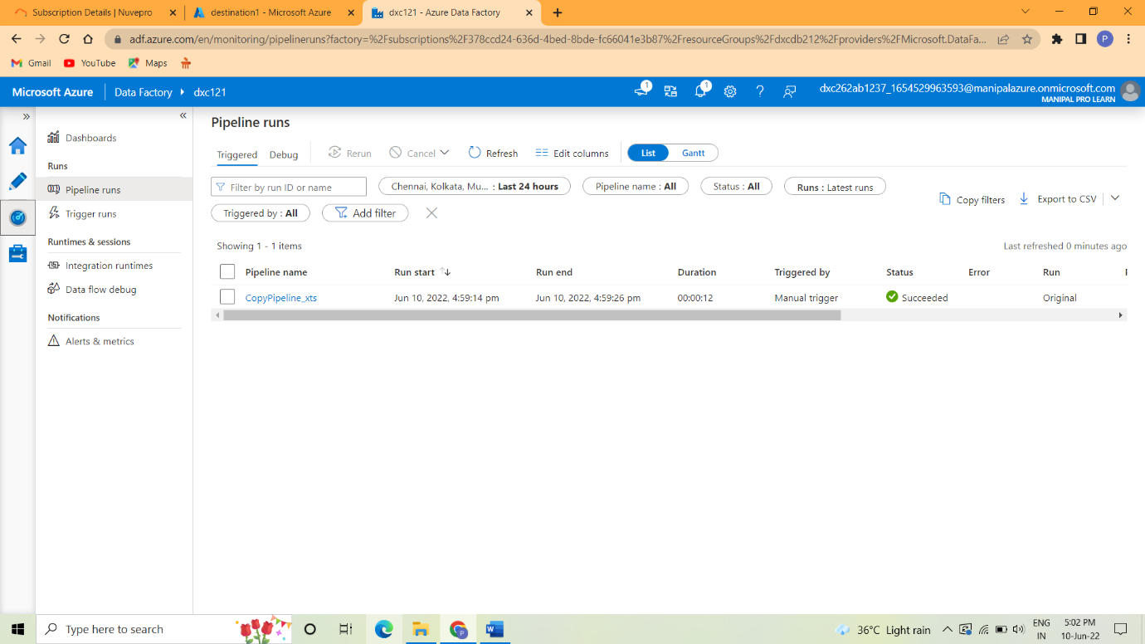
CREATING BLOB TRIGGER
Trigger run successfully.

Slide 12
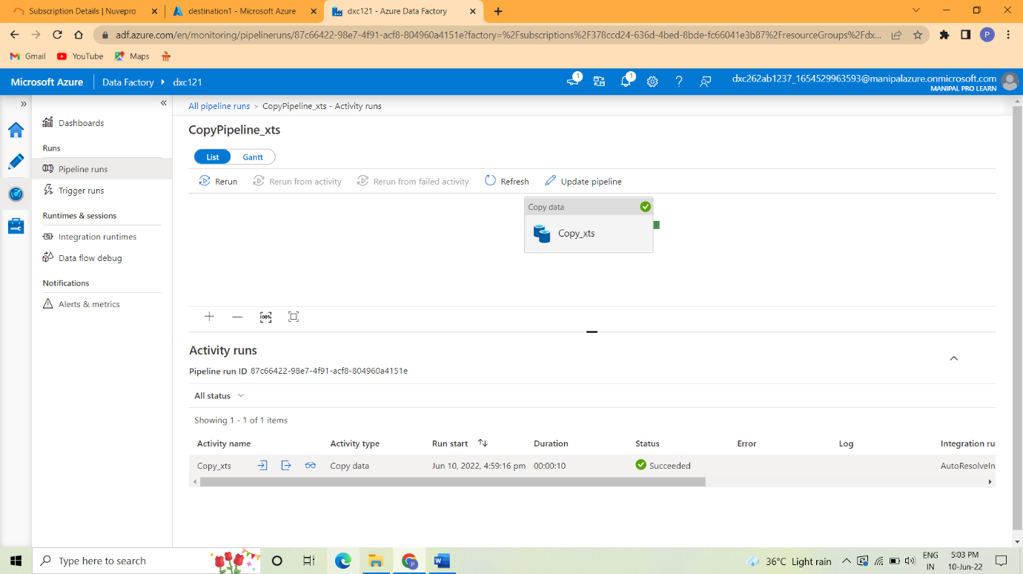
BLOB TRIGGER
Blob Trigger

Slide 13
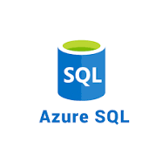
AZURE SQL DATABASE
Azure SQL Database is a fully managed platform as a service (PaaS) database engine that handles most of the database management functions such as upgrading, patching, backups, and monitoring without user involvement.
With Azure SQL Database, you can create a highly available and high-performance data storage layer for the applications and solutions in Azure.

Slide 14
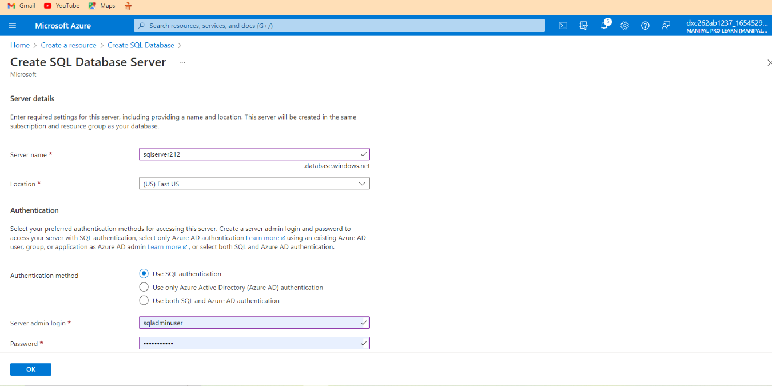
AZURE SQL DATABASE
Create SQL Server and SQL Database

Slide 15
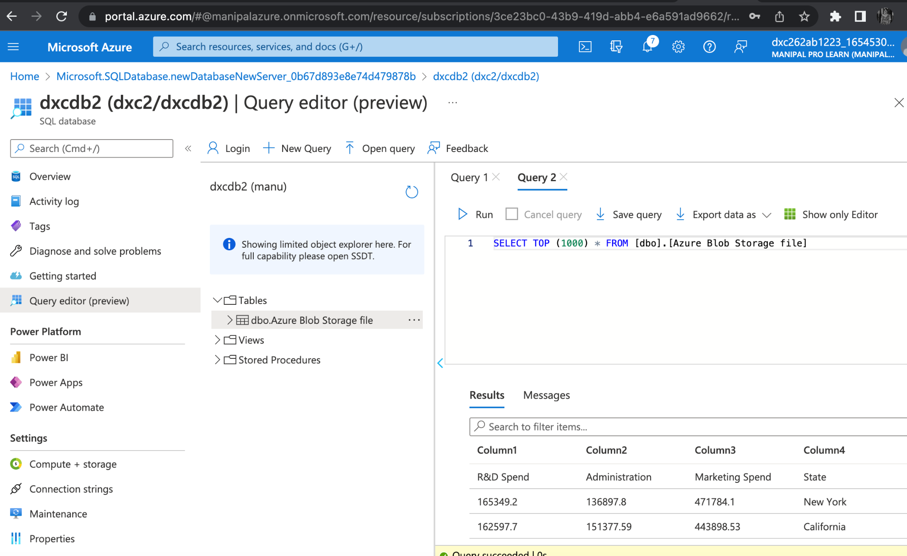
RESULT
Navigate to the SQL database in order to check the data.

Slide 16
CONCLUSION
Using Azure Data Factory, we were able to create a pipeline that will validate and copy the blob data into the SQL database in this project.
The Blob data has been validated and put in the SQL database.

Slide 17
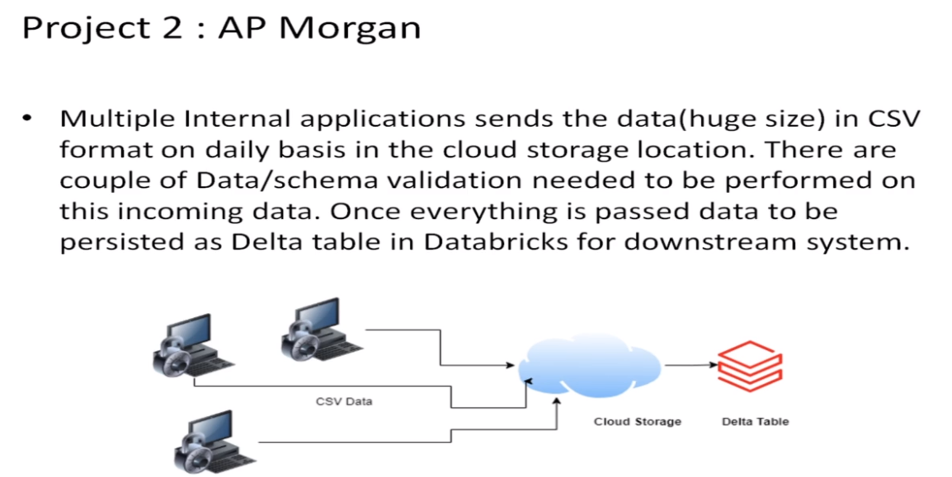
PROJECT 2 : AP MORGAN DATA PLATFORM
AIM : Azure Databricks Linked Service in Azure Data Factory.
PROJECT OUTLINE:

Slide 18
MODULES
Create data bricks
Creating the cluster in data bricks
Adding notebook in data bricks and Implement BI
Creating data factory
Creating azure data bricks linked service in azure data factory

Slide 19
RESOURCES
To complete this project we need the resources
Azure Data Factory
Azure Data Bricks

Slide 20
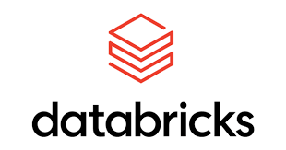
AZURE DATA BRICKS
Azure Databricks is a data analytics platform optimized for the Microsoft Azure cloud services platform.
Azure Databricks offers three environments for developing data-intensive applications: Databricks SQL, Databricks Data Science & Engineering, and Databricks Machine Learning.

Slide 21
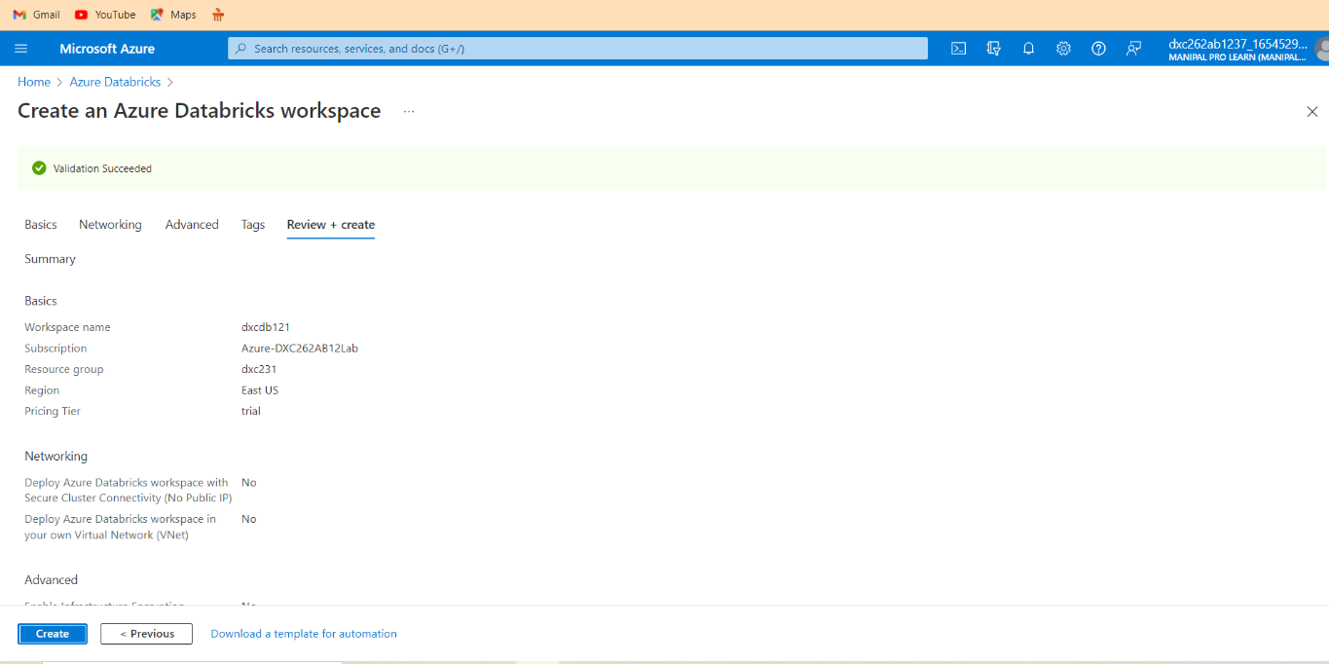
AZURE DATA BRICKS
Create the Azure Data Bricks workspace.

Slide 22
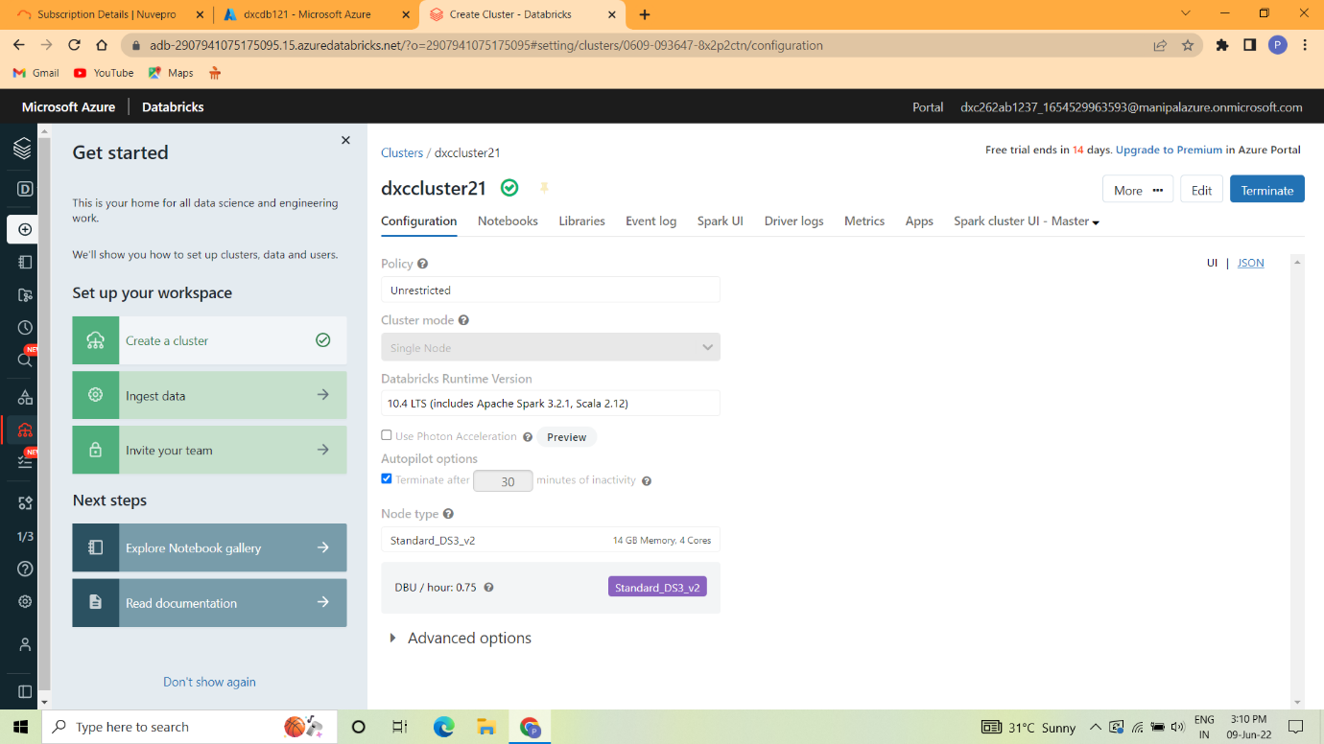
CREATING THE CLUSTERS IN DATA BRICKS
Cluster is created in the data bricks.

Slide 23
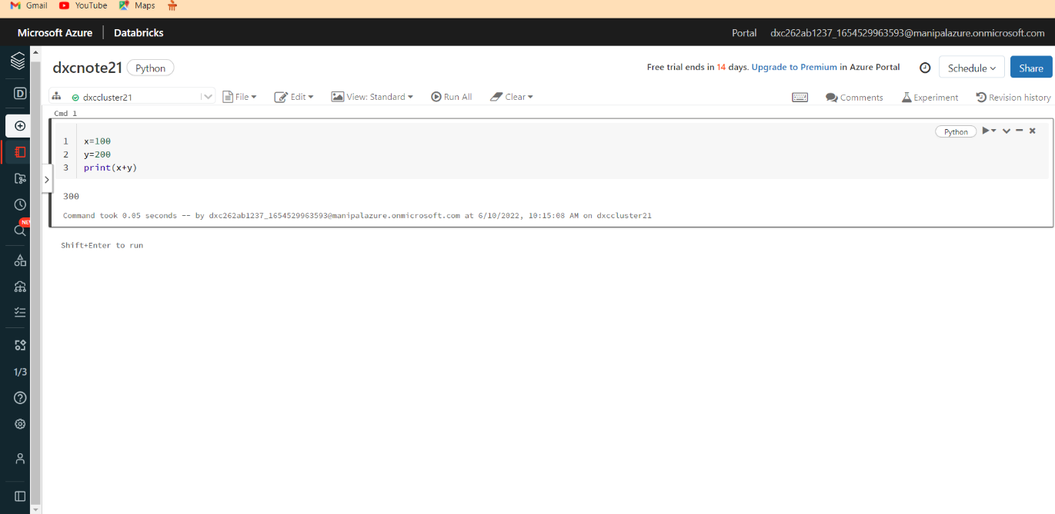
ADDING NOTEBOOK IN THE CLUSTER
Notebook is created.

Slide 24
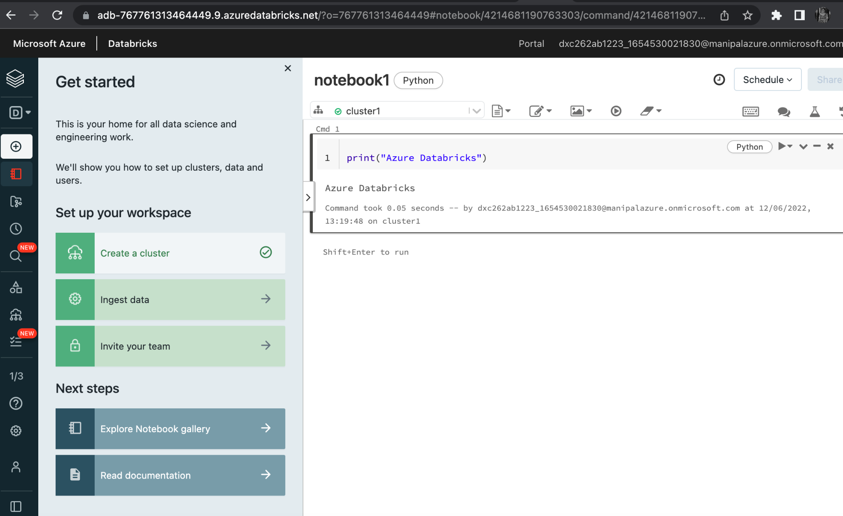
IMPLEMENT THE BUSINESS LOGIC IN NOTEBOOK
BI is implemented.

Slide 25
CREATE AN AZURE DATA FACTORY
Azure Data Factory is created.

Slide 26
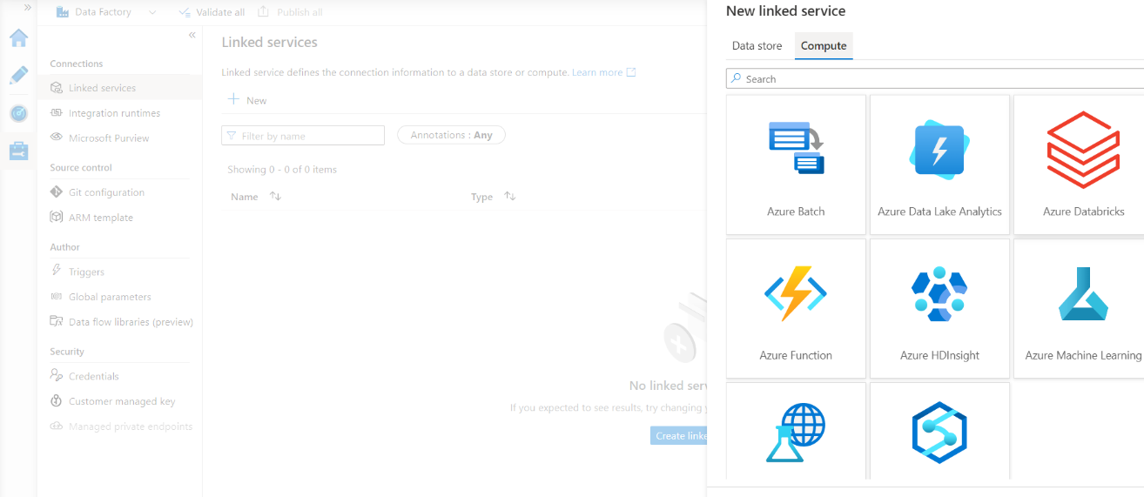
AZURE DATABRICKS LINKED SERVICES IN ADF
Click Linked services under Connections, then select Add New from the Manage option on the left side.
Select Compute > Azure Databricks and then Continue in the New connected service box.

Slide 27
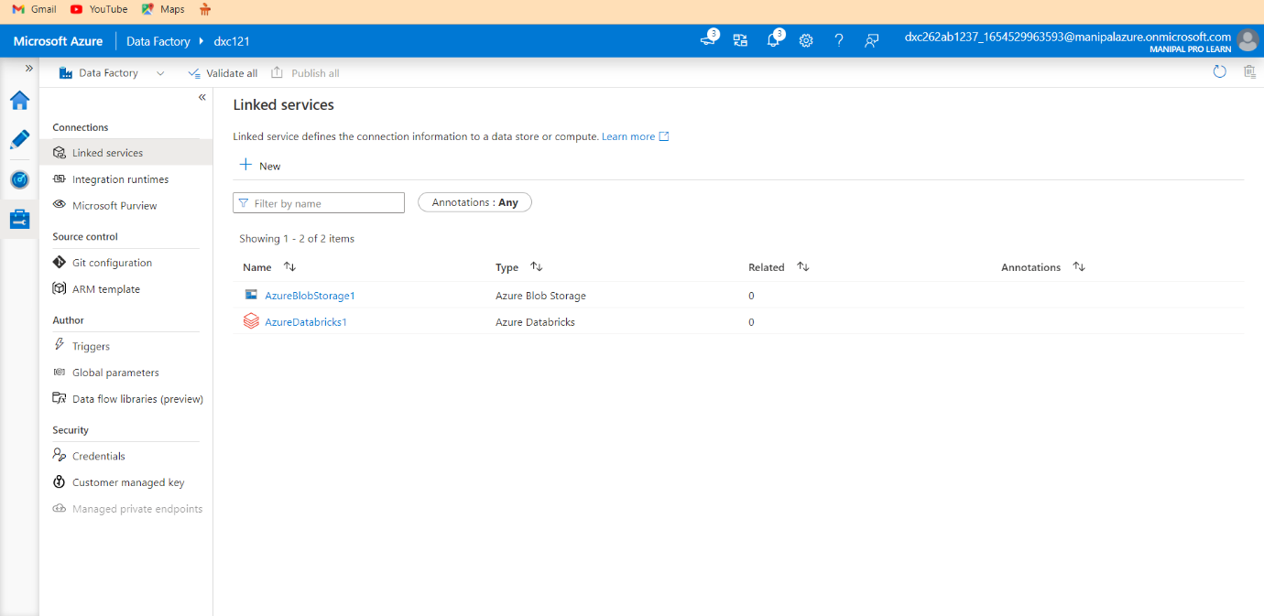
AZURE DATABRICKS LINKED SERVICES IN ADF
Azure Data Bricks is linked successfully.

Slide 28
AZURE DATABRICKS LINKED SERVICES IN ADF
Now create a pipeline
Drag the notebook tab from the Azure Databricks drop down onto the workspace of the pipeline

Slide 29
AZURE DATABRICKS LINKED SERVICES IN ADF
Publish the pipeline and then we can trigger and run the pipeline
Trigger the pipeline and monitor the pipeline run

Slide 30
RESULT
Data Factory has successfully triggered a linked notebook of Data bricks

Slide 31
CONCLUSION
Using Data Factory, I was able to successfully link and trigger an Azure Data Bricks notebook.
Azure Data Factory and Azure Data Bricks are related.

Slide 32
THANK YOU!!

